Slide 1

MACHINE
INTELLIGENCE
Ensemble Models and
Bayesian Learning
K.S.Srinivas
Department of Computer Science
and Engineering

Slide 2

Machine Intelligence
Unit III
Emsemble Models and Bayesian Learning
Srinivas K S
Department of Computer Science

Slide 3
Ensemble Learning
An ensemble method is a
technique that combines the predictions from multiple machine learning algorithms together
to make more accurate predictions than any individual model.
The learners that we use are usually weak learners
They are among the most powerful techniques in machine learning, often outperforming other methods.
This comes at the cost of increased algorithmic and model complexity

Slide 4
Ensemble Learning
The key idea 1 we have learners where the output is slightly better than chance i.e the accuracy is a little better than 50% but not significantly higher
Multiple learners can be modelled using
Different Algorithms
Different Hyperparameters of the same algorithm
Different subsets of the training data
Different features of the training data
The key idea 2 They construct multiple, diverse predictive models from adapted versions of the training data (most often reweighted or resampled);
They combine the predictions of these models in some way, often by simple averaging or voting (possibly weighted).

Slide 5
General Approach

Slide 6
General Approach
We have seen that decision trees earlier have a tendency to overfit i.e they have high variance
We could offcourse prune trees but is often difficult.
Ensemble learning ensures that the combined out of several weak learners produce a final model that has low variance
Given a set of n independent observations Z1, . . . , Zn, each with variance σ2, the variance of the mean Z^ of the observations is givenby σ2/n.
In other words, averaging a set of observations reduces variance.

Slide 7
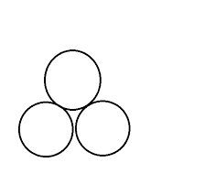

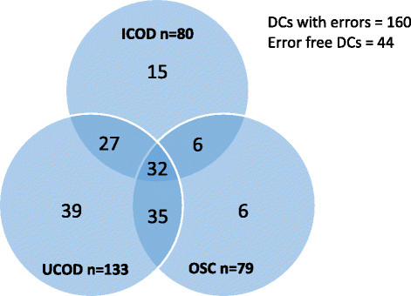
Intuition behind ensemble learning
Lets take the example of the 3 learners on the right.
Let the box be the instance space and the errors produced by each of the learners marked as circles
Lets take an arbitrary point marked in pink and make a prediction
Now the Red makes an error on the sample but the Green and Blue guys get it right
The average variance is lower.
Key Concept: The errors made must be independent
But that’s not always the case. Look at this picture .
The intersection areas could actually result in the voting being wrong for the pink points

Slide 8
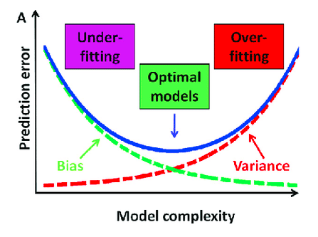
Bias Variance - Recap
Low Bias and Low Variance
A model with high bias is too simple and has low number of predictors
Due to which it is unable to capture the underlying pattern of data.
It pays very little attention to the training data and oversimplifies the model. This leads to high error on training and test data.
Any model which has very large number of predictors will end up being a very complex model
which will deliver very accurate predictions for the training data that it has seen already but this complexity
makes the generalization of this model to unseen data very difficult i.e a high variance model.
Source:https://towardsdatascience.com/holy-grail-for-bias-variance-tradeoff-overfitting-underfitting-7fad64ab5d76

Slide 9

Bias and Variance
We have seen in neural networks that if we have very large number of epochs we may overfit
Low Bias – High flexibility (DT/ANN)
High Variance – we give different subsets of training data we get different models
More flexible representations(Low Bias) have High variance
More powerful representations have high variance
We want to have a low bias and low variance model
.
The ensemble itself will produce a model with low bias and low variance as illustrated earlier
In fact even if the individual learners have high bias the new combined learner will have a low bias
The hypothesis of the new learner may not even be in the HS of the individual learners
Basics models perform not so well by themselves either because they have a high bias (low degree of freedom models, for example) or because they have too much variance to be robust (high degree of freedom models, for example)

Slide 10

Many weak learners increase our confidence
Ensemble prevent overfitting
We don’t need to worry about stopping criteria
Lets assume we have n learners in a binary classification problem
If all of them have an accuracy of 0.7 and predict the same class for a given instance, what would your confident be on the prediction
In Reality not all learners would predict the same nor would they have the same accuracy
Lets assume that n1 of those learners predict class1 and n2 class2
Lets also assume that with no loss of generality that n1 > n2 , meaning that if we took a voting the prediction would always be class 1
The probability of the class being really class1 would be
$$C=\left[1−{\left\{1−A\right\}}^{n}\right]$$
$$n_{C_{R}P^{R}{\left(1−P\right)}^{n−R}}=n_{C_{n_{2}^{∗}}\left(A\right)}n⋅{\left(1−A\right)}^{n⊥}$$

Slide 11
Combining ensemble learners
Learners can be unweighted
Learners can be weighted wt ȡ accuracy , 1/variance of the learner
For making a prediction using weights

Slide 12
Challenges in ensemble learners
The critical point of ensemble learners is that they need to be independent
averaging a set of observations reduces variance.
Which can be achieved by either using different subsets or different learners .
Shall see this in the next session – Bagging and Boosting

Slide 13
Types of Ensemble Methods
Manipulate data distribution
Example: bagging, boosting
Manipulate input features
Example: random forests
Manipulate class labels
Example: error-correcting output coding

Slide 14
Machine Intelligence
Unit III
Bagging
Srinivas K S
Department of Computer Science

Slide 15
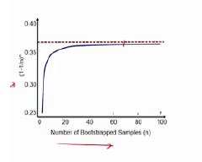

Bagging
One way of having different learners to have independent errors is by splitting the data into subsets and passing them to different learners
But since training instances could be small we may end up with overfitting and high variance
Instance we would could randomly sample from the data set creating new data sets of the same size as the original or a very large fraction of the data set with replacement
This method is called bootstrap aggregation or bagging
It has been shown when we create a data set as described above we would have close to 67% of data from the original data set about 33% of original data is not selected for a sufficiently large sample size
P(Data not being selected) =

Slide 16
Bagging
Multiple subsets are created from the original dataset, selecting observations with replacement.
A base model (weak model) is created on each of these subsets.
The models run in parallel and are independent of each other.
The final predictions are determined by combining the predictions from all the models. (Voting or averaging)

Slide 17
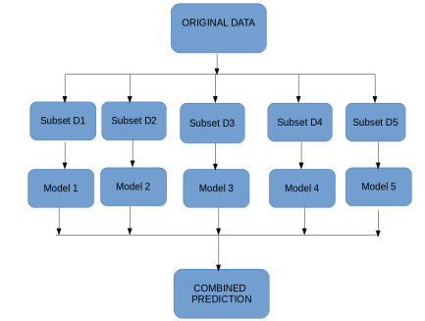
Bagging

Slide 18
Bagging Error Calculation
We can do K-fold cross validation for error calculation
Typically 1/3 of samples are left out in every subset.
These are the out of bag examples
All you have to do is measure the error on the unused sample in those learners that did not use them
The average of the error from the learners gives us the error for that sample
you can accumulate their error overall those data points that are out of bag and calculate an average
The error calculation is close to the leave out one approach

Slide 19
How many learners and Advantages
Most research has shown that about 100 learners are good enough
You can formulate these output probabilities

Slide 20
Machine Intelligence
Unit III
Boosting
Srinivas K S
Department of Computer Science

Slide 21
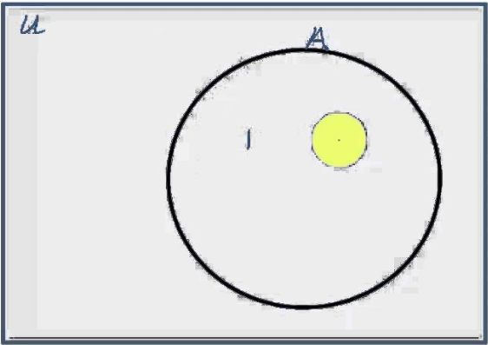
Boosting - Preamble
Let different learners have different weights ( earlier stated by accuracy or by variance)
Let each learner progressively learn from the previous learner
Let U be the instance space and A be the training data
Let a Hypothesis h1 misclassify the instances in yellow
By learning progressively I mean the 2nd learner h2 is told make other errors but ensure that the h1 misclassified instances are learnt correctly
By giving higher weights to those sample
Ensure the weights of the samples that were got right reduced
Make sure the sum of all weights add up to 1

Slide 22
Boosting vs Bagging
In the case of Bagging, any element has the same probability to appear in a new data set.
However, for Boosting the observations are weighted and therefore some of them will take part in the new sets more often.
One of the most popular Boosting techniques is the “Adaboost”

Slide 23
Boosting Overview
Most example on boosting use a weak learner called a decision stump
This has one node and based on the value does a binary split
Boosting approach instead learns slowly and incrementally

Slide 24
Boosting Overview
Most example on boosting use a weak learner called a decision stump
These red crosses on the right are basically mis-classifications
Adjust the weights of those points.
Further classify after assigning weights.
Ensure the weights of the samples that were got right reduced
the classier that you use in the end is basically the summation of all the individual classifiers

Slide 25
Boosting Overview
There is chance to overfit
have a weighting factor here α. Have α1, α2 and α3 for each of the learners to get your final decision boundary
These weights have some mechanism that we will see shortly which is dependent on number of errors made
Some learners are better than others so give them higher weights

Slide 26
THANK YOU
Srinivas K S
Department of Computer Science & Engineering
srinivasks@pes.edu

Slide 27
MACHINE
INTELLIGENCE
AdaBoost
K.S.Srinivas
Department of Computer Science
and Engineering

Slide 28
Machine Intelligence
AdaBoost
Srinivas K S
Department of Computer Science

Slide 29
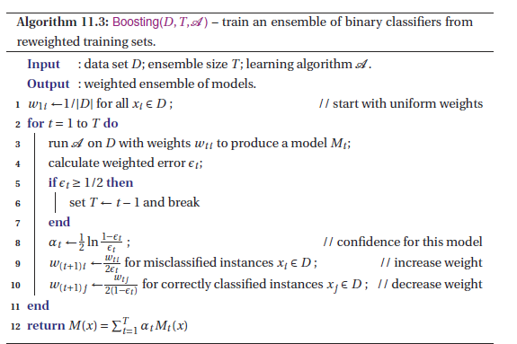
Adaboost – The Algorithm
Source: Peter Flach – Machine Learning – The art and science of algorithms that make sense of data

Slide 30
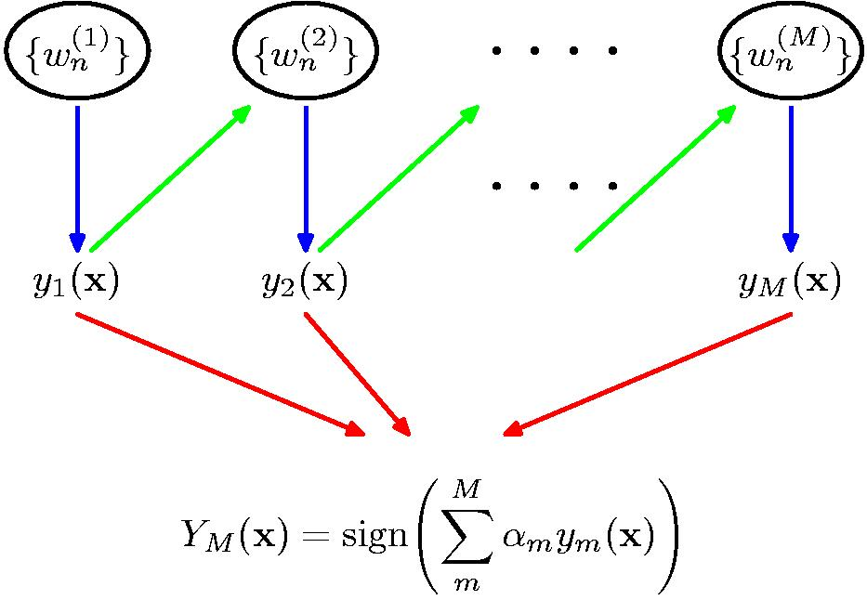
Schematic illustration of Boosting

Slide 31
Adaboost – Broken down in simple terms
There is only 1 Data set being used
Initialize each of the instances to the same normalized weight i.e w = 1/N , N= number of instances
Choose the learner with the highest accuracy as your start learner say h1(x)
Run the algorithm and collect the error rate = % of misclassified examples
Ensure that h2(x) does not classify the misclassified points of h1(x)
This perforce means that h2(x) runs after h1(x)
Continue and perform h3(x) making sure that it does get h2(x) errors right
Finally take a vote of all the hypothesis (offcourse weighted) and state the hypothesis
There are 2 weights – instance weights and hypothesis weights

Slide 32
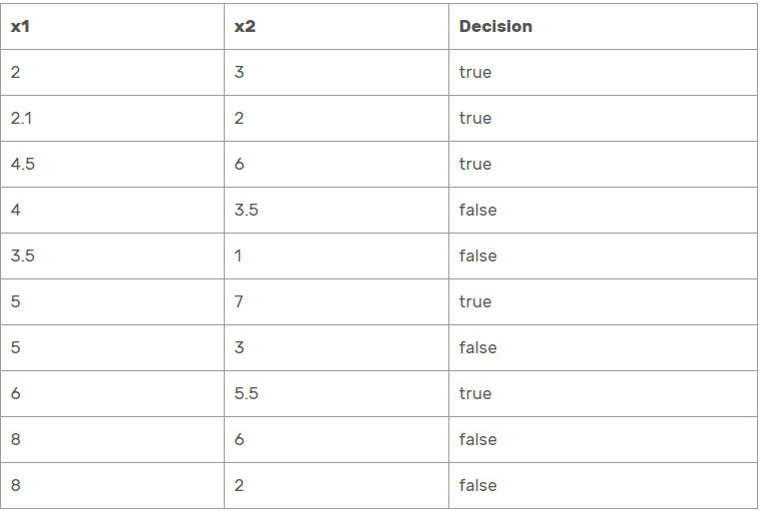
Adaboost
So lets walk thru the algorithm with all its gory details ☺
Get your instance set that you will use for training
Source: https://sefiks.com/2018/11/02/a-step-by-step-adaboost-example/

Slide 33
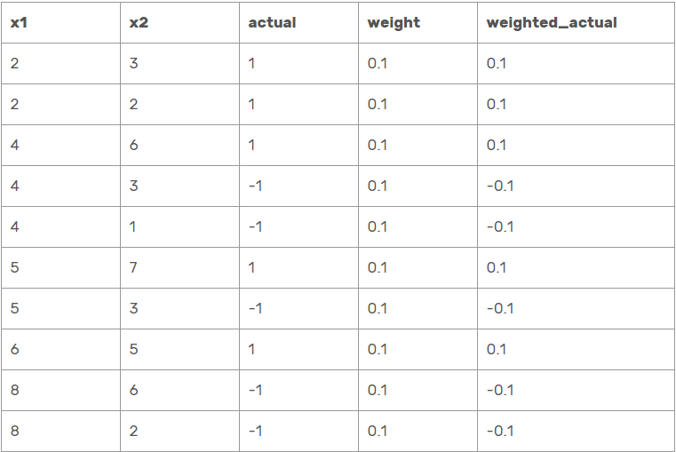
Adaboost
1st weight – instance weight
When we start the algorithm have the same weight
So assign weights as 1/N = 1/10 (ten sample)
Since we are using a binary classifier convert true +1 and false to -1
Source: https://sefiks.com/2018/11/02/a-step-by-step-adaboost-example/

Slide 34
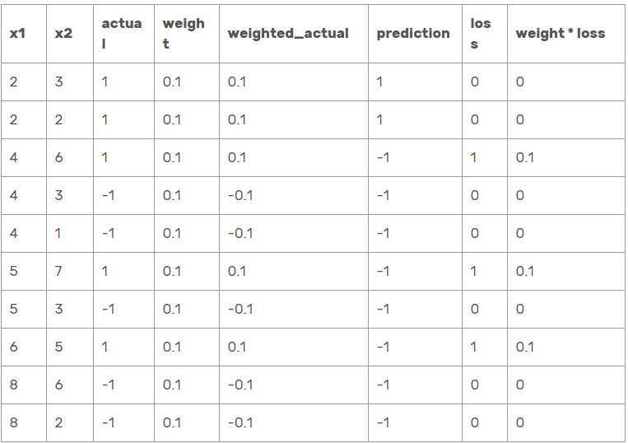
Adaboost
Create many decision stumps such as if x1 < 2.1 it to be +1 and X1>= 2.1 as -1
You can create many such stumps and choose the one with the lowest error rate
Assume that the decision stump above is the best one (Not true ) but for this example lets just assume
Lets make a prediction and calculate the error rate
Source: https://sefiks.com/2018/11/02/a-step-by-step-adaboost-example/

Slide 35
Adaboost
Evaluate the error for the m^{th} classifier. Here w_{n}^{( m)} is the weight of the n^{th} data instance in the m^{th} iteration. The Identity function:
I(a,b) = 1 if a != b and = 0 otherwise.
Then evaluate the value of the classifier using:
α_{m} = ½ * ln{ (1 – ε_{m})/ε_{m}}

Slide 36

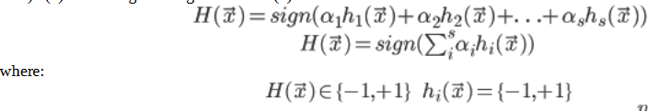
Adaboost
Sum of weight times loss column stores the total error
It is 0.3 in this case.
Compute the Stump weight . I will not prove it but the alpha is got by taking a partial derivative of the error with respect to error .
alpha = ln[(1-epsilon)/epsilon] / 2 = ln[(1 – 0.3)/0.3] / 2
alpha = 0.42
Remember our final H(x) is a weighted sum of individual hypothesis
So alpha 1 is 0.42 for our first decision stump
Source: https://sefiks.com/2018/11/02/a-step-by-step-adaboost-example/

Slide 37
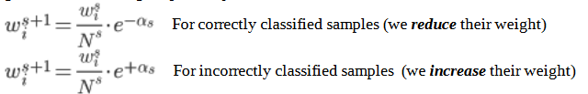
Adaboost
The other main funda in adaboost is that the next learner must learn from its previous learner
The way to be doing this is by upping the weights of the instances that it got wrong and reducing the weights of the instances that it got right
This is done thru the expression
Which is take each instance and multiply it with e raised to –alpha if correctly classified and e raised to +alpha if incorrectly classified
The Term N is a normalizer is because we said that the sum of all weights must add upto 1
Lets derive N now
Source: https://sefiks.com/2018/11/02/a-step-by-step-adaboost-example/

Slide 38
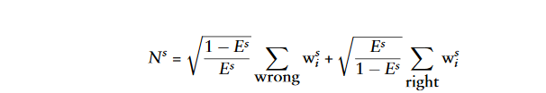
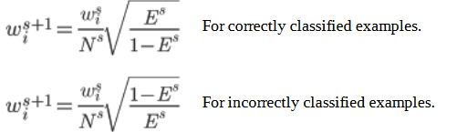
Adaboost
Source: https://sefiks.com/2018/11/02/a-step-by-step-adaboost-example/

Slide 39
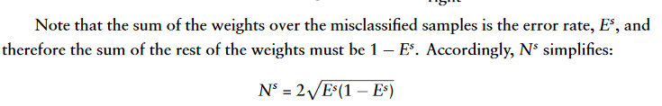
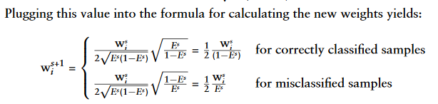
Adaboost
Sum of all weights must be 1
Source: https://sefiks.com/2018/11/02/a-step-by-step-adaboost-example/

Slide 40
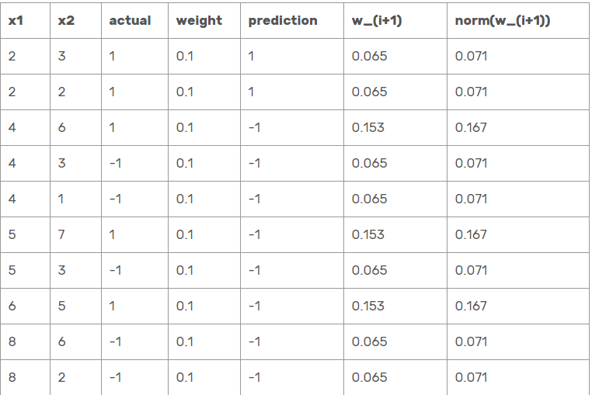
Adaboost
We’ll use alpha to update weights in the next round.
w_{i+1} = w_{i} * math.exp(-alpha * actual * prediction) where i refers to instance number.
Also, sum of weights must be equal to 1. That’s why, we have to normalize weight values. Dividing each weight value to sum of weights column enables normalization.
Source: https://sefiks.com/2018/11/02/a-step-by-step-adaboost-example/

Slide 41
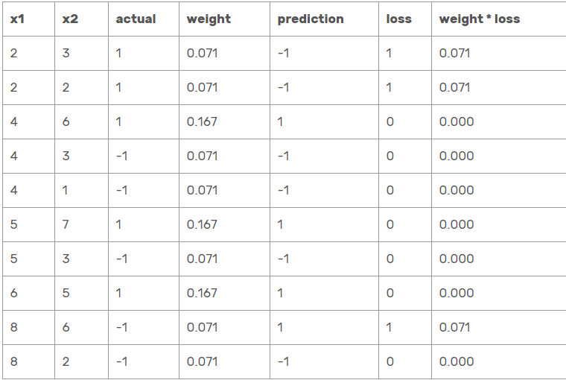
Adaboost
In the next round I choose x1 < 3.5 as -1 and x1>= 3.5 as +1
Off course I use the new weights this time.
Source: https://sefiks.com/2018/11/02/a-step-by-step-adaboost-example/

Slide 42
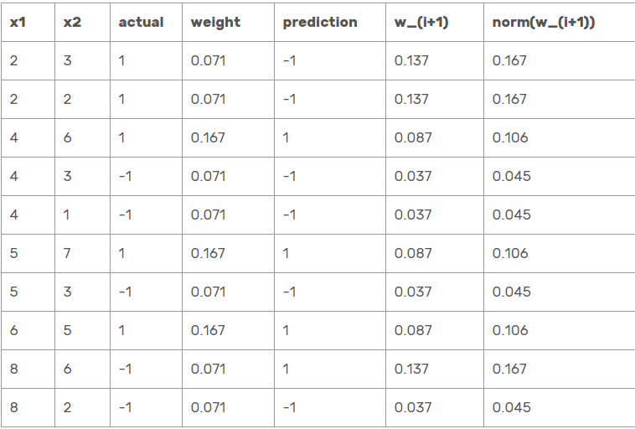
Adaboost
You can calculate epsilon, alpha and new weights using the same procedure
epsilon = 0.21, alpha = 0.65
And find weights for the next round
You can calculate epsilon, alpha and new weights using the same procedure
Source: https://sefiks.com/2018/11/02/a-step-by-step-adaboost-example/

Slide 43

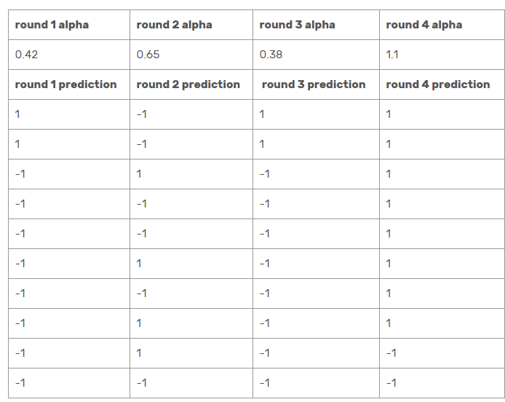
Adaboost
At each round I update my final hypothesis
I have given a table here and the calculations for 4 rounds
Source: https://sefiks.com/2018/11/02/a-step-by-step-adaboost-example/

Slide 44
Adaboost
At each round I update my final hypothesis
I have given a table here and the calculations for 4 rounds
Source: https://sefiks.com/2018/11/02/a-step-by-step-adaboost-example/

Slide 45
Adaboost
For example, prediction of the 1st instance will be
0.42 x 1 + 0.65 x (-1) + 0.38 x 1 + 1.1 x 1 = 1.25
And we will apply sign function
Sign(0.25) = +1 aka true which is correctly classified.
Source: https://sefiks.com/2018/11/02/a-step-by-step-adaboost-example/

Slide 46
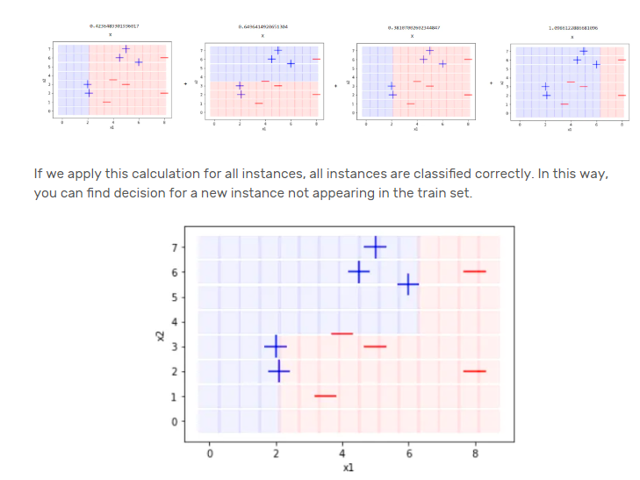
Adaboost
Source: https://sefiks.com/2018/11/02/a-step-by-step-adaboost-example/

Slide 47
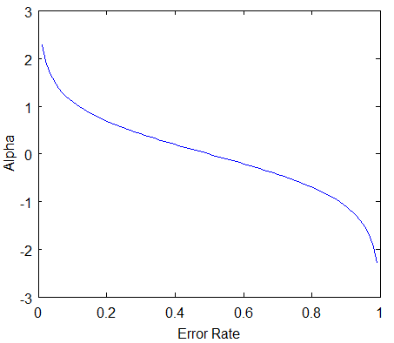
Alpha vs Error
A plot of the “value” of a classifier vs the Error rate will be as follows.

Slide 48
Alpha vs Error
We can see that when the error rate is 0, alpha is close to infinity ( very high value for the classifier).
If error rate = 0.5, value = 0. This makes sense because the classifier with error rate = 0.5 is as good as a “coin tosser”.
If error rate = 1, then everything is gotten wrong by the classifier and hence value is –infinity.

Slide 49
Adaboost toy example
Please try a calculation of this as a home assignment
X | 0 | 1 | 2 | 3 | 4 | 5 | 6 | 7 | 8 | 9
Y | + | + | + | - | - | - | + | + | + | -

Slide 50
THANK YOU
Srinivas K S
Department of Computer Science & Engineering
srinivasks@pes.edu

